Slide 1
Webex Calling in Webex for Government
Cloud calling, the way you want it
November 2023
Cloud Connectivity

Slide 2
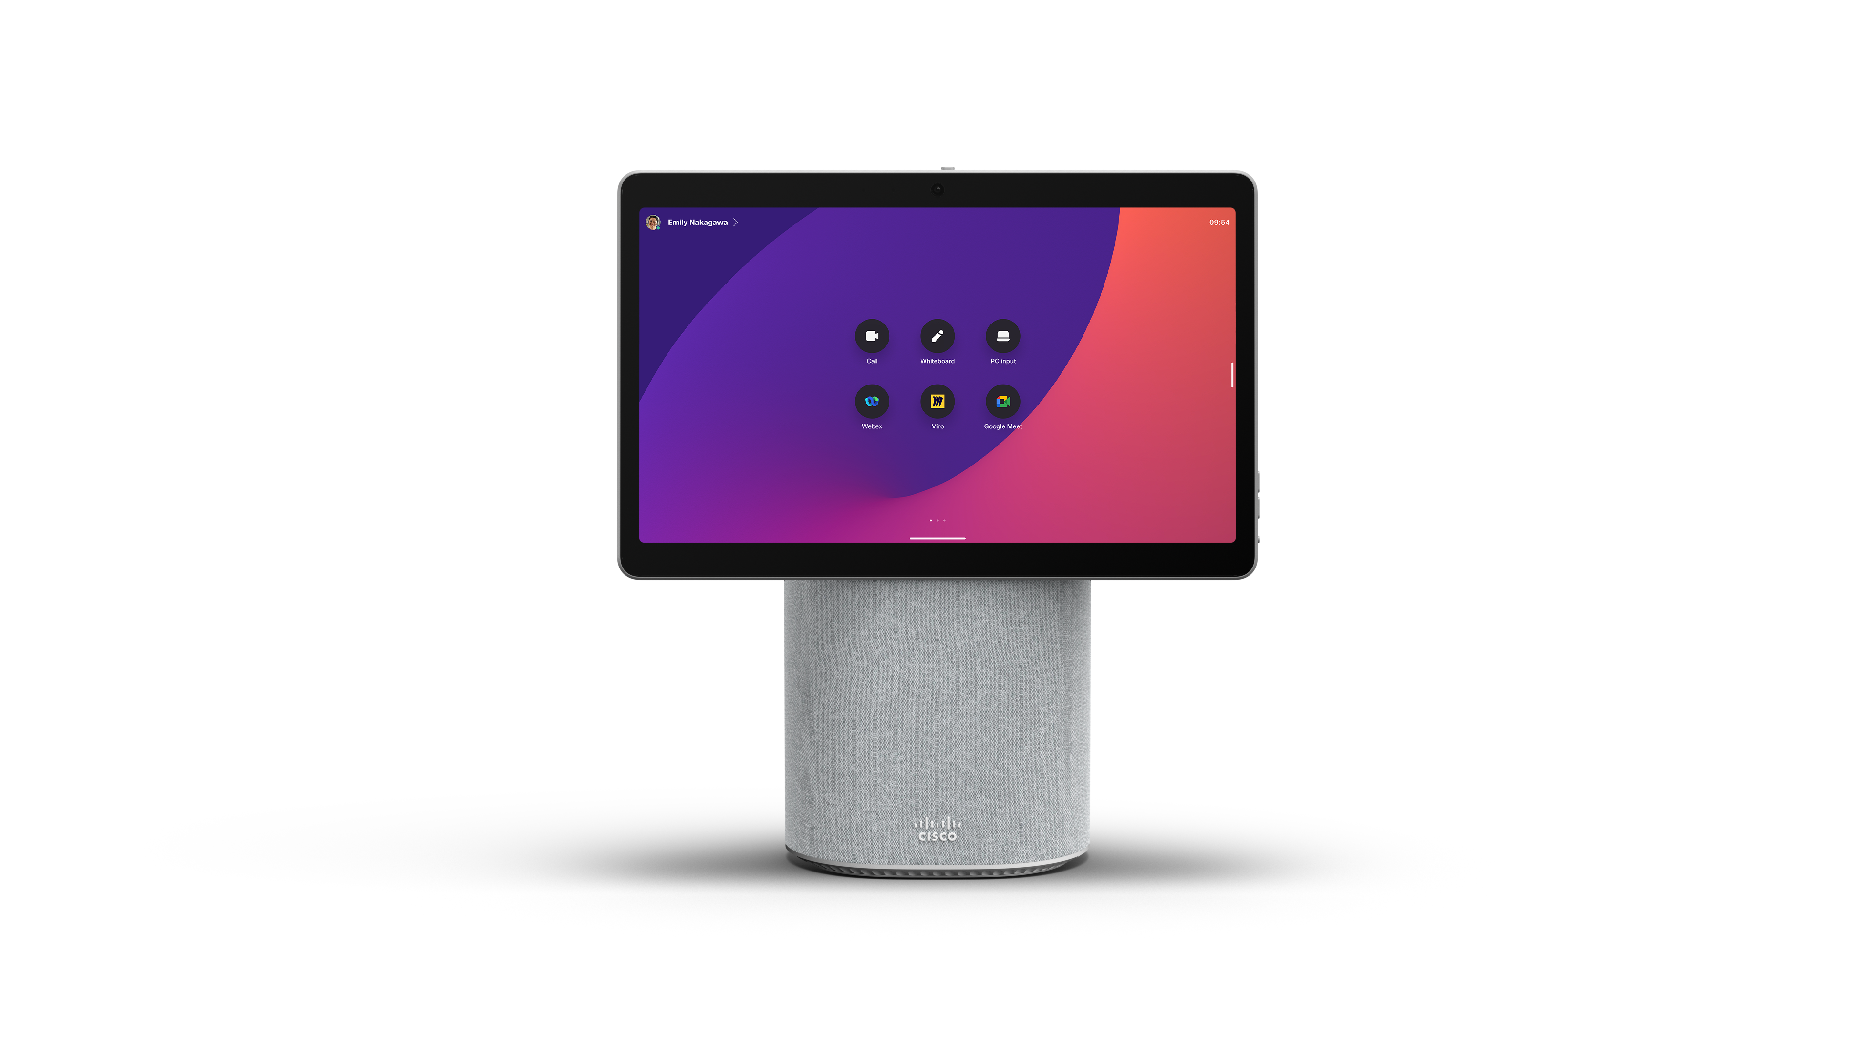
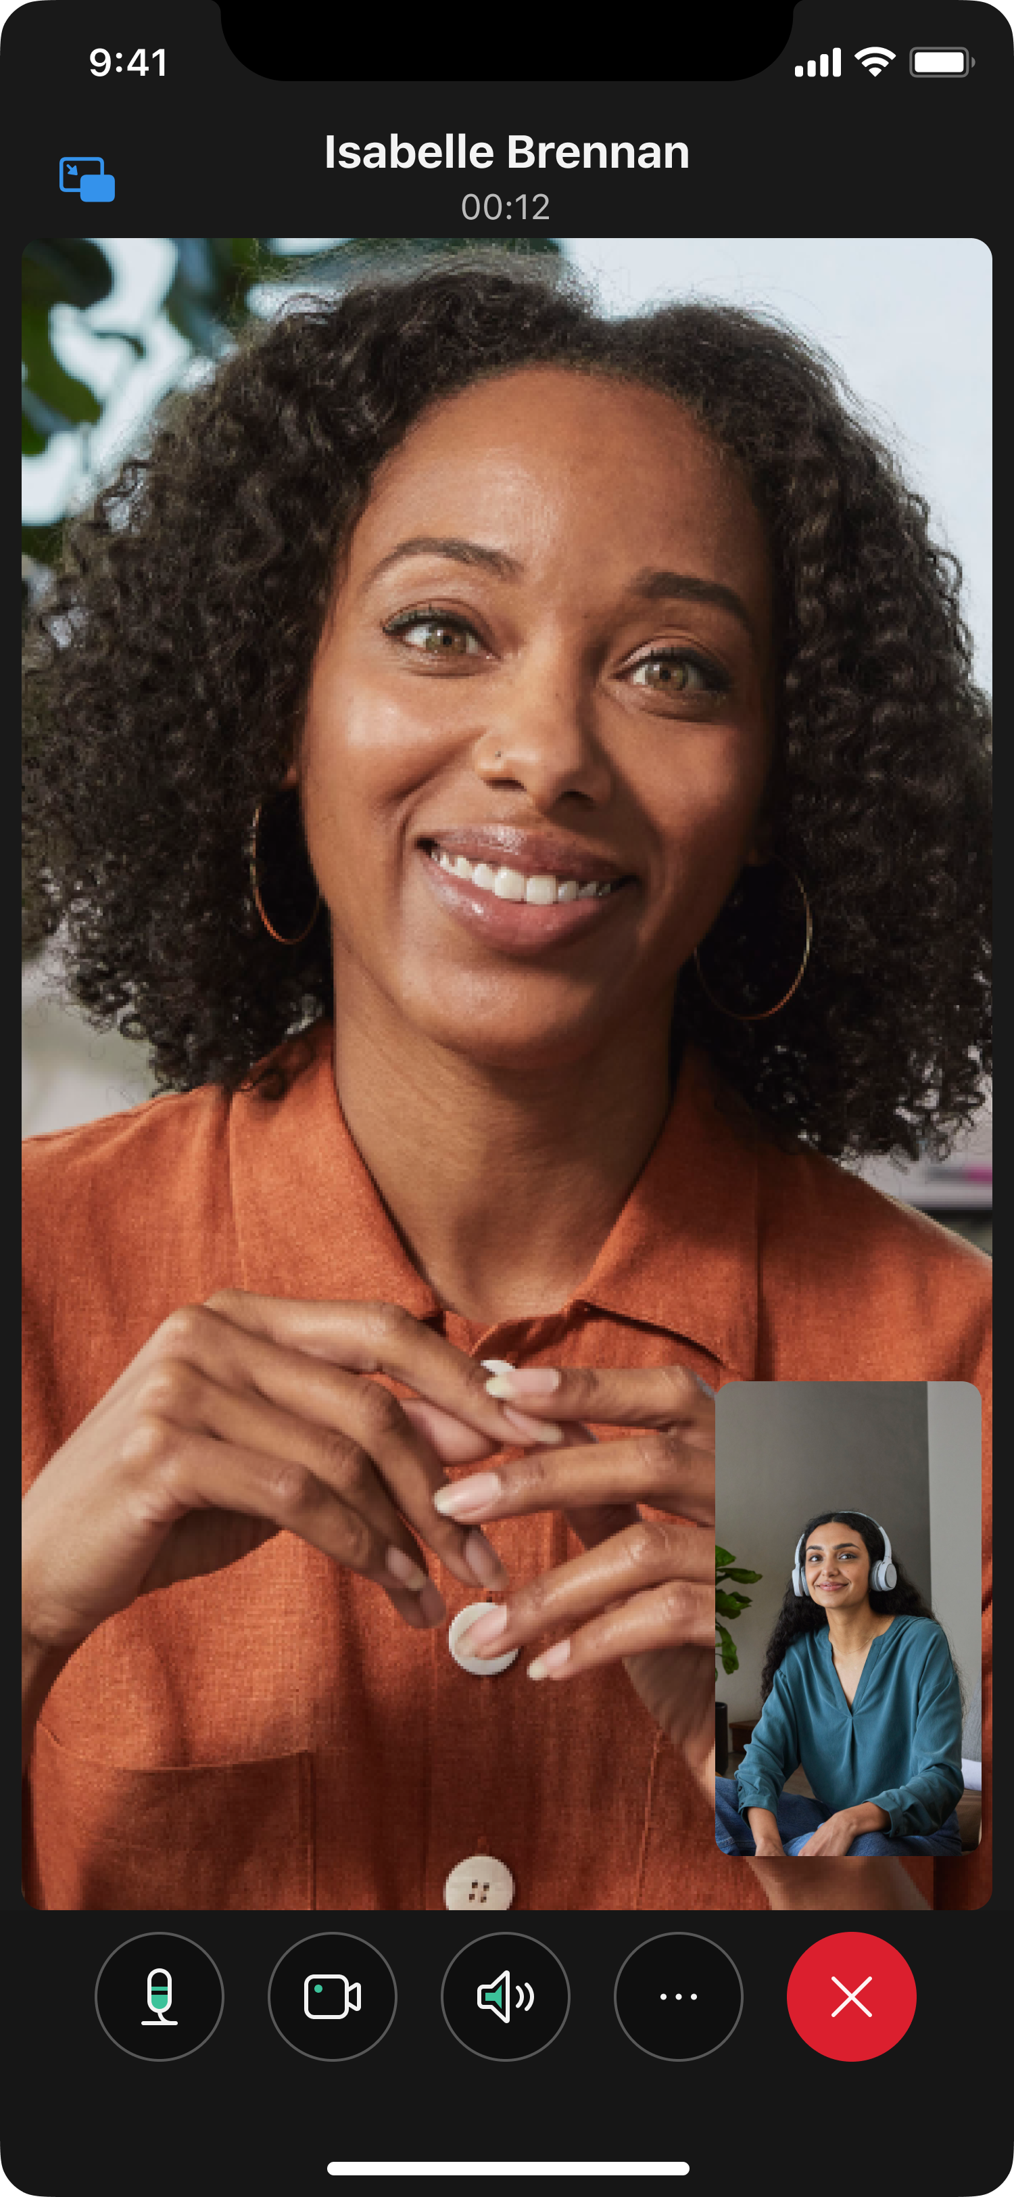
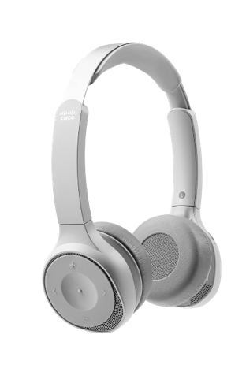
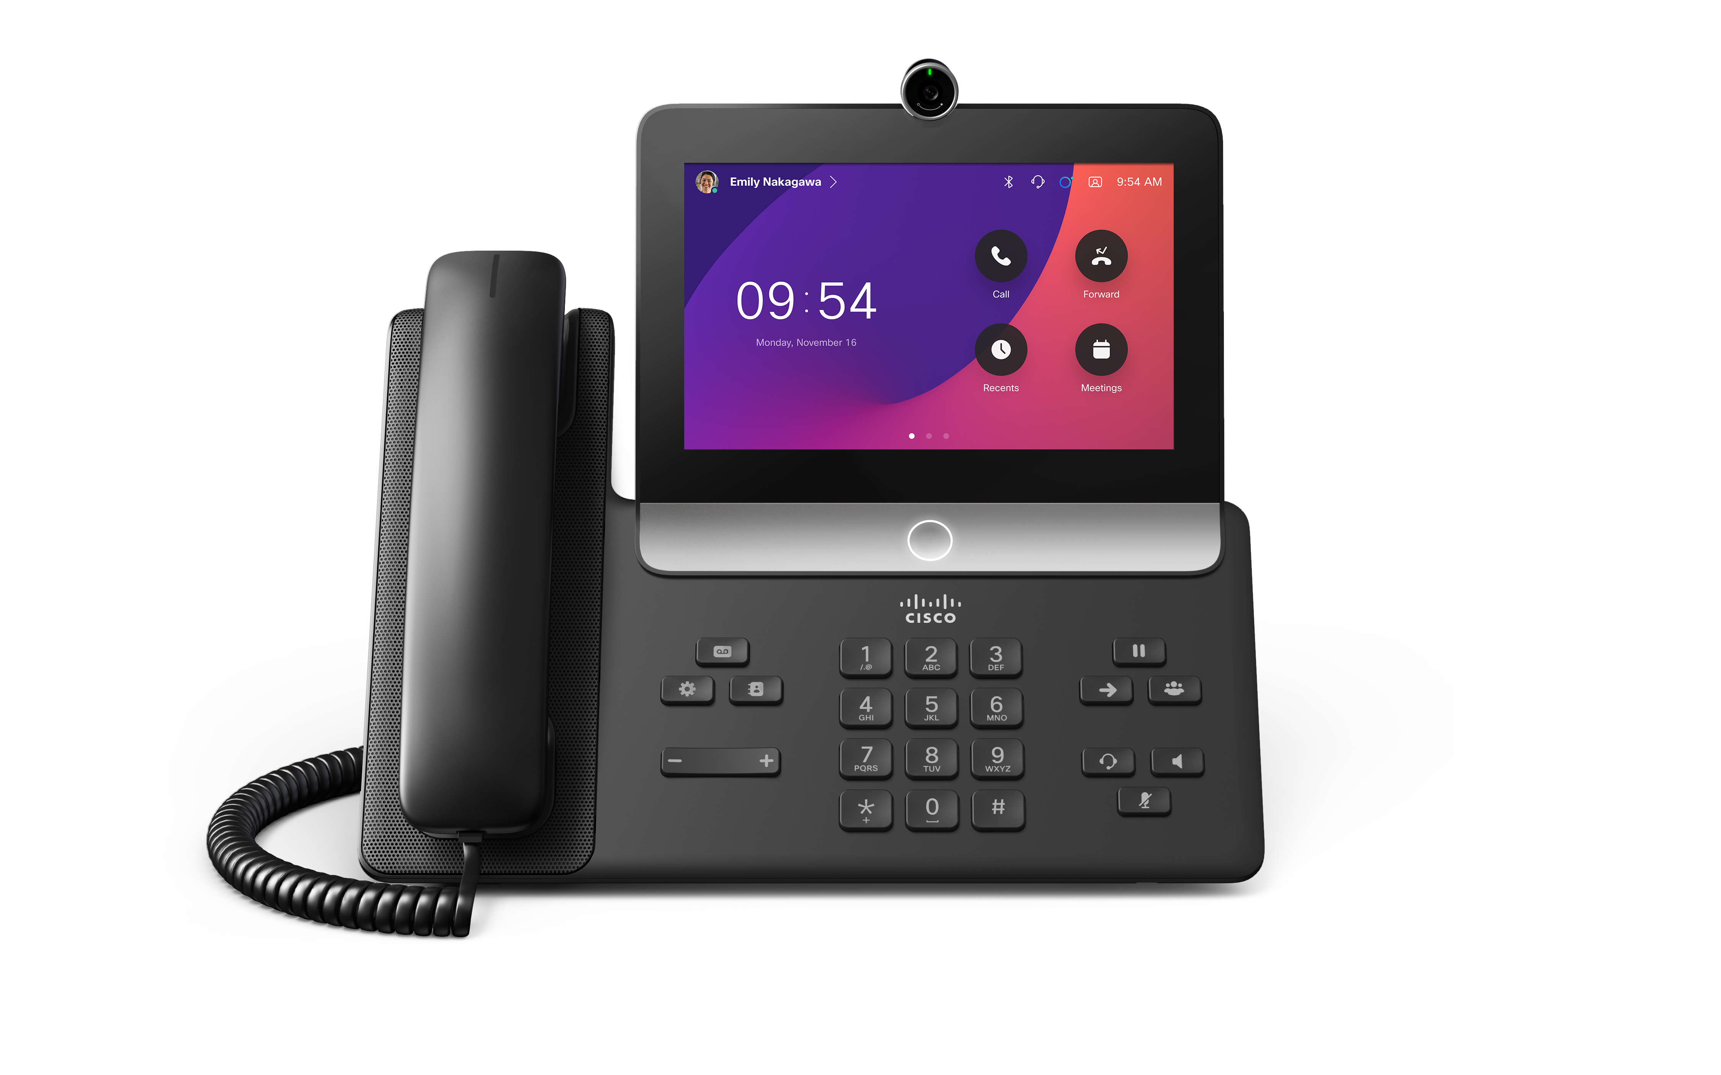
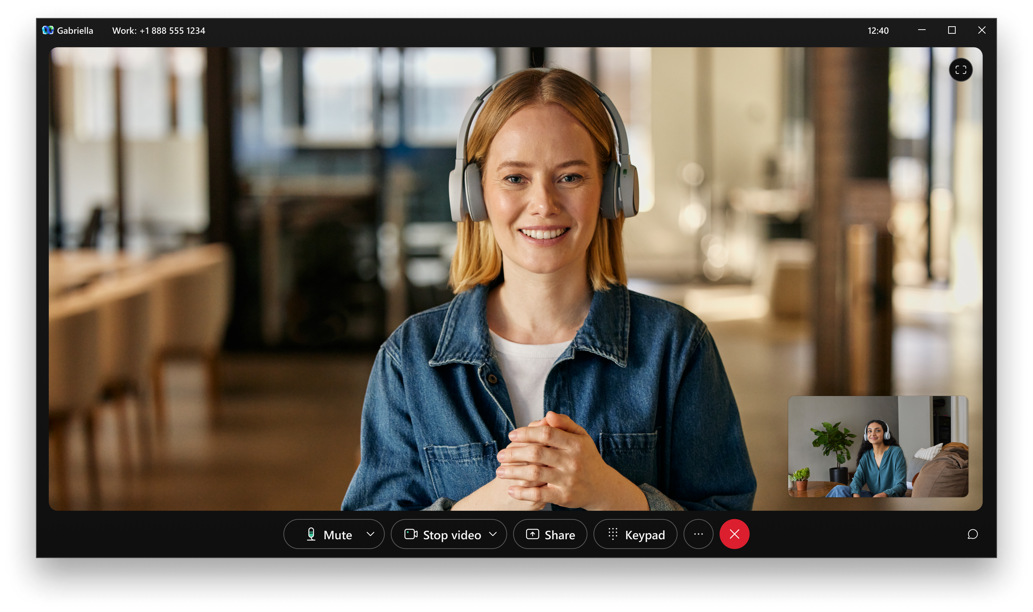
Webex Calling in Webex for Government
Enterprise-grade calling features
Easy-to-use, secure, and reliable
Flexible migration to cloud
Unparalleled global coverage
Centralized management and administration via Control Hub
FedRAMP Moderate Authorized

Slide 3
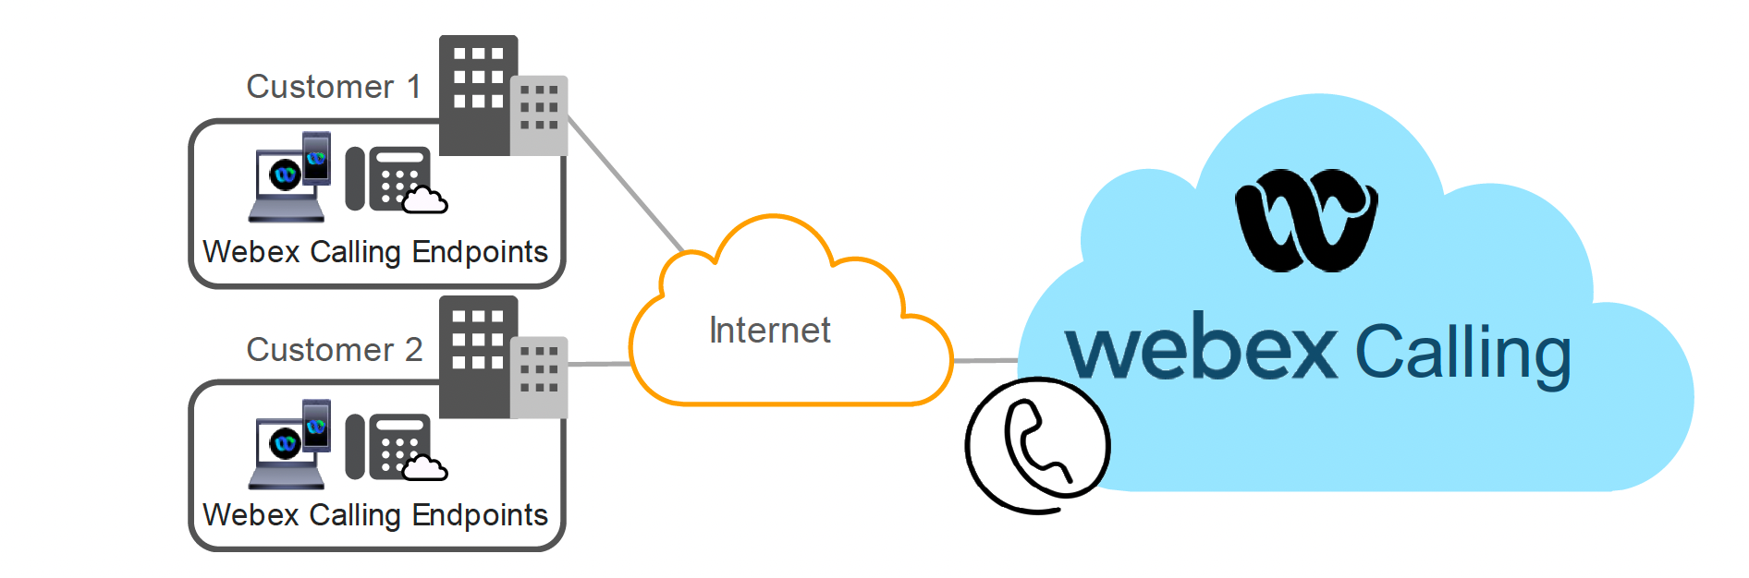
Webex Calling Multi-Tenant
Multi-Tenant service is primarily delivered via an over-the-top internet access to the Webex Cloud
Additional private access options via Webex® Edge Connect or a Private Connect are also available

Slide 4

Peering

Slide 5



PSTN Connectivity - Local Gateway
Enables a BYO PSTN option for Webex Calling
Continue using your existing provider
Manage phone numbers in Control Hub
May provide connectivity to an on-premises IP PBX or SBC
Can be partner hosted
Access
Network
PSTN
Customer site
Local
gateway
Note: Additional PSTN options on the roadmap
SBC or
IP PBX
PSTN
Webex® endpoints

Slide 6
Access Connectivity
OTT Registration
Webex Edge Connect
Private Network Connect
Webex Calling supports device (phone & Webex App) registration over-the-top (OTT)
No value-add service
Customers who have a presence in Equinix can leverage Webex Edge Connect to extend signaling to Webex Calling and/or Meetings for a more reliable communication path
Webex Calling customers can extend their network over PNC once an interconnect is established from the partner network to the Webex Calling Data Center
$
$
Potential Services Revenue
Potential Services Revenue

Slide 7

Edge Connect

Slide 8

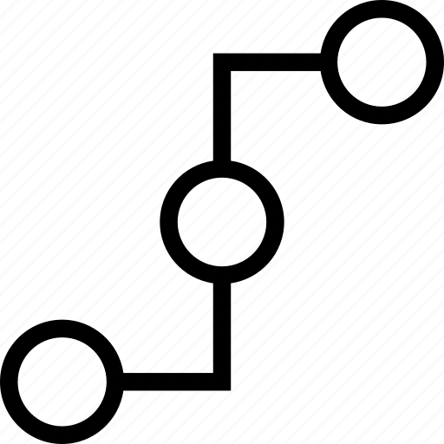


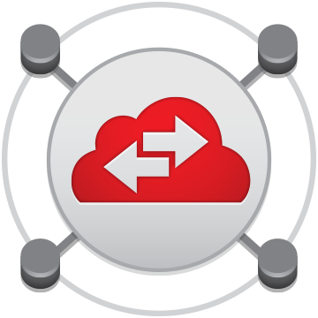



Edge Connect – Equinix Fabric (ECX)
Benefits
Private circuit (not over internet)
Deterministic network path
Predictable and stable latency and jitter
Guaranteed bandwidth
Speed options: 200M, 500M, 1G, 2G, 5G,10G
Available Services
Webex Calling (MT and DI) *
Webex Meetings
Webex app, Devices and Video Mesh media **
Webex Edge Audio
* DI requires separate Equinix Fabric VCs (until “triple play” with single VC is supported)
** Webex app, Webex Devices and Video Mesh require internet access for signaling
Enterprise
Equinix Fabric
Cisco
Customer needs to pay: - SP: circuit to Equinix - Equinix: customer cage, Equinix Fabric Port, Equinix Fabric VCs - Cisco: Edge Connect

Slide 9
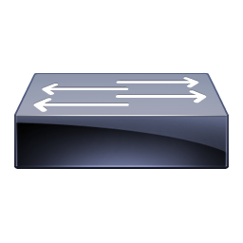

Equinix Fabric
Customer needs to connect to Equinix Fabric
Equinix responsible for layer 1 (cross connects) and layer 2 (Equinix Fabric VC to Webex)
Cisco responsible for Webex side of layer 3 BGP peering
Physical Circuit: Network circuit between Customer and Equinix. May have traffic to multiple cloud providers.
Equinix “Port” – A port is the physical port that was ordered in Equinix Fabric that is connected from Equinix Fabric backbone to the customer equipment in the cage (router/switch).
Equinix “Connection” - This is where a customer uses the Equinix Fabric portal to submit a request to connect to a Cloud Provider. This submission contains the BGP and routing information required for the peering.
Customer
Customer Cage
Cisco Webex
Circuit
Port
BGP Peering
Connection

Slide 10
Webex Edge Connect for Calling/Meetings
Webex public cloud – customer address space must be public and provider-independent IPv4. - Requires NAT at edge of customer private network. - Public IPv4 with /30 or /31 for peering link - Webex accepts up to 100 prefixes with maximum length prefix of /29. - Webex advertises multiple prefixes with maximum length of /24 (recommendation that customer allows up to 500 prefixes in BGP).
Equinix Fabric VC to an Edge Connect DC location.
Several redundancy options: 1. Active/Passive local Redundancy – can purchase redundancy option with Edge Connect license (lower price). 2. Active/Active Local Redundancy – requires 2 x Edge Connect licenses. 3. Active/Active and Active/Passive Geographically Dispersed Edge Connect Circuits – requires 2 x Edge Connect licenses.

Slide 11
Webex Calling MT (& Meetings) over Edge Connect
Webex Routes
AMER
64.68.96.0/19
64.68.104.0/21
….
APAC
69.26.176.0/20
69.26.176.0/22
….
EMEA
62.109.192.0/18
….
Private
Public
Internet
Redistribute
Equinix
OSPF
BGP
BGP
Customer Routes (NAT)
100.64.1.x
100.64.2.x
…
Advertise
Customer
Network

Slide 12
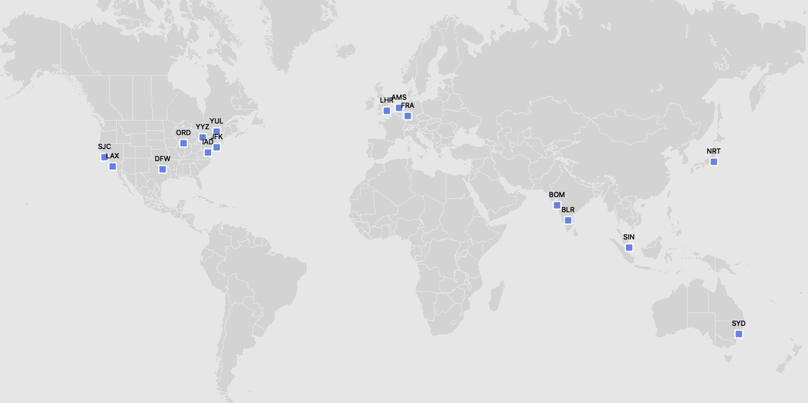

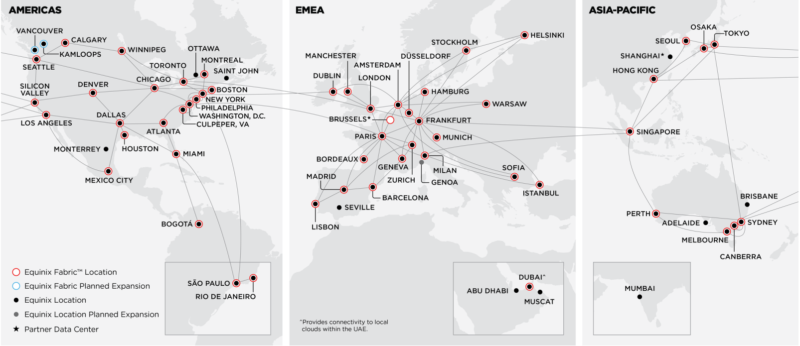
Edge Connect Data Center locations
Webex Cloud Exchange Connectivity
Equinix Fabric
Webex Calling Multi-tenant (and Meetings): connect to any Edge Connect location
Dedicated Instance: connect to both Edge Connect locations with DI in a region
E
Amsterdam
E
London
Toronto
Montreal
E
E
E
Chicago
E
Frankfurt
E
New York
E
Tokyo
E
Ashburn
Silicon Valley
E
E
Dallas
E
Equinix Fabric extended locations
Singapore
E
Sydney
E

Slide 13
Private Network Connect

Slide 14
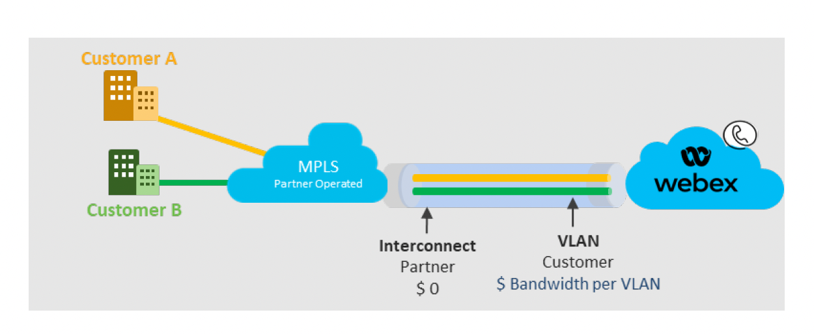
Private Network Connect
https://help.webex.com/en-us/article/k1burf/Connect-Customer-Private-Network-to-Webex-Calling
The Private Network Connect (PNC) feature allows Webex Calling customers to extend their private network to the cloud. This is done through either partner cloud or direct connect
PNC must be used in conjunction with an IP Interconnect to a Webex Calling data center
PNC provides access to Webex Calling workloads. Other Webex workloads and network services (Meetings, Messaging, DNS, Control Hub, etc.) are accessed over the top (OTT). Customers desiring a direct connection to the Webex Suite of workloads should consider Webex Edge Connect.
Note that Private Network Connect is NOT the same as the DI/UCMC “Partner Connect”.
Notes:
PNC is available to partners and is ordered for customers through the Cisco Commerce Workspace (CCW). Once ordered in CCW, the feature is visible and configurable within Control Hub.

Slide 15
Ordering Access Peering

Slide 16
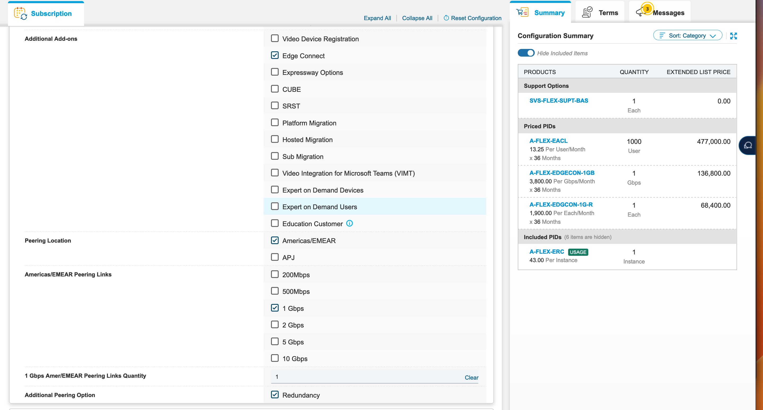
Ordering in CCW Edge Connect

Slide 17
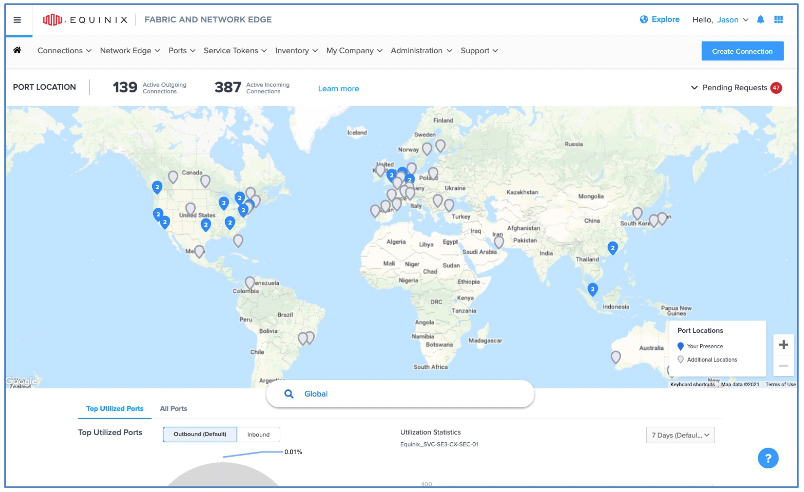
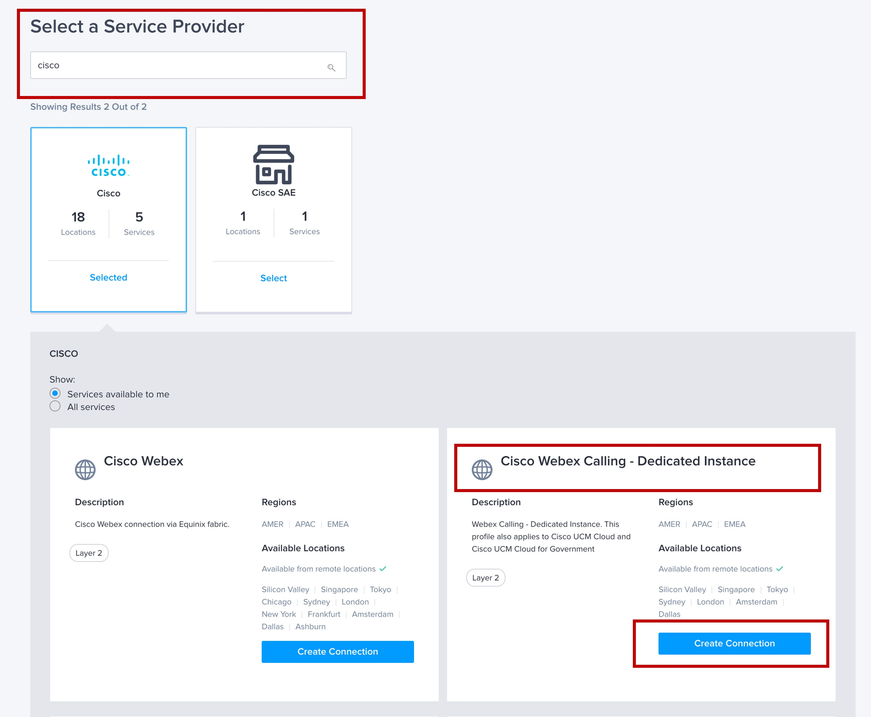
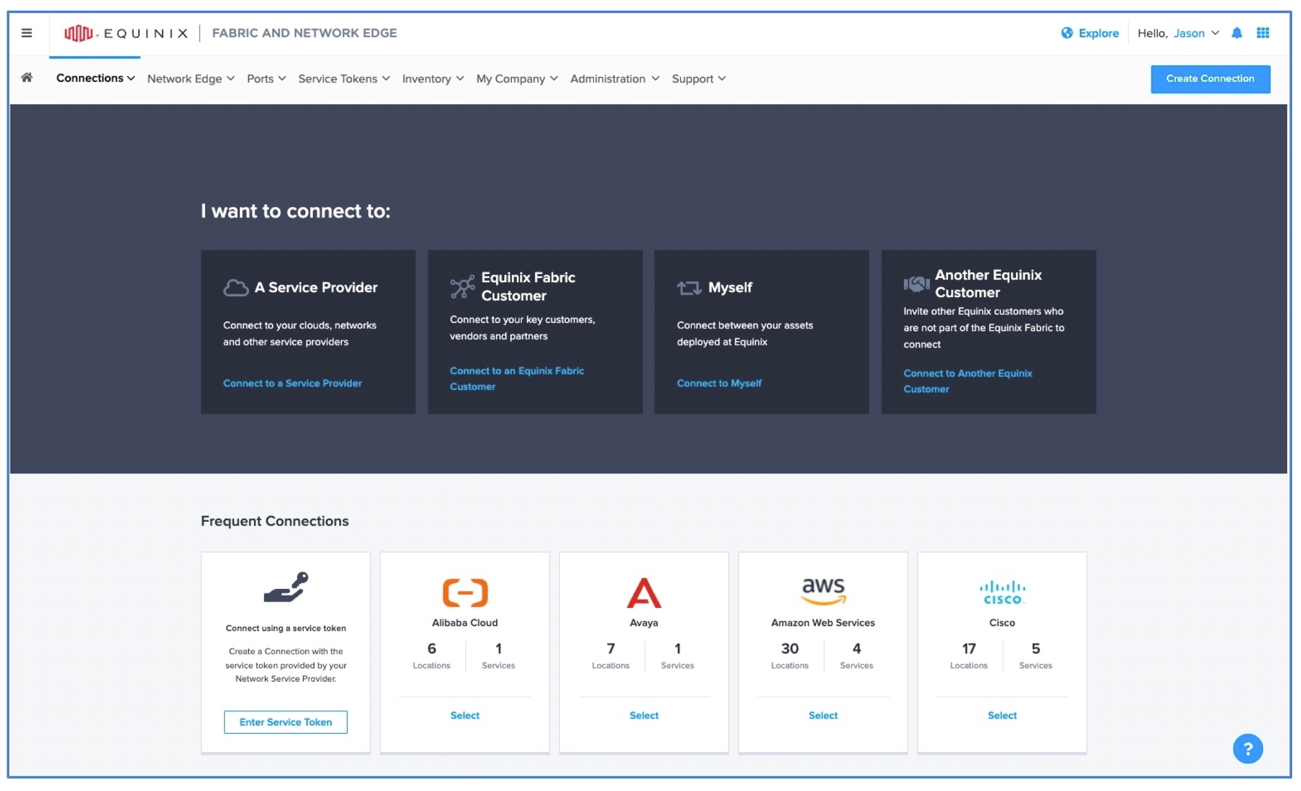
Equinix Fabric Connection (VC) Ordering
Webex Calling MT
& Meetings
Dedicated Instance

Slide 18
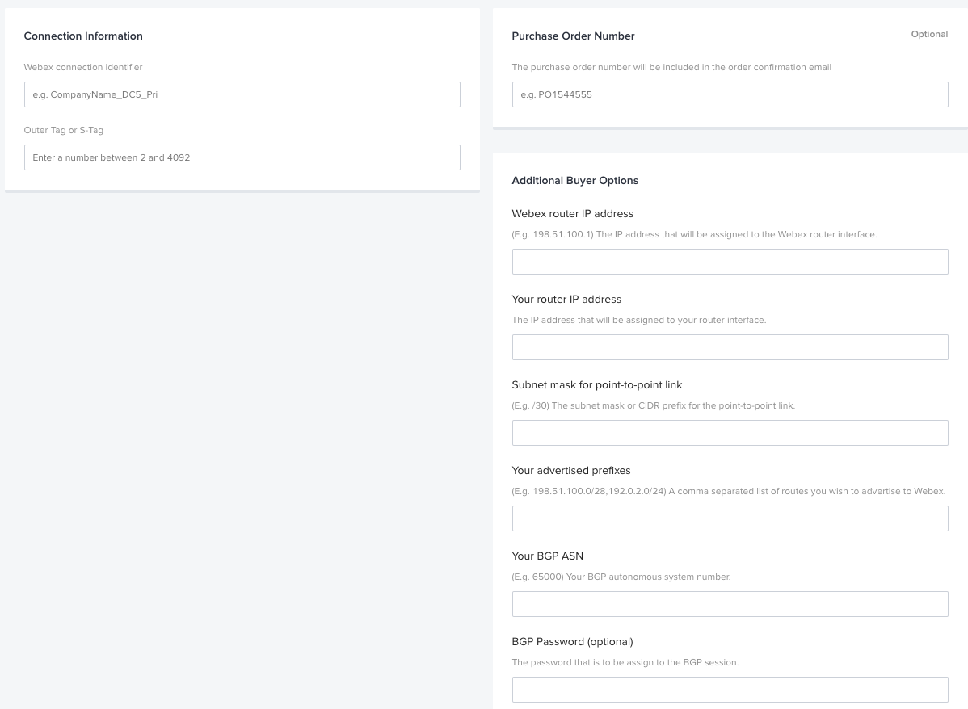
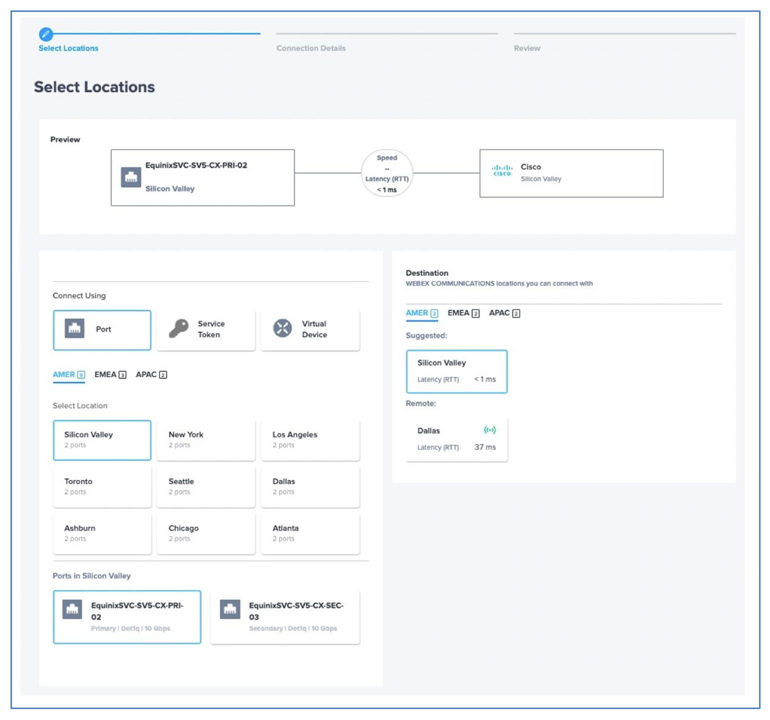
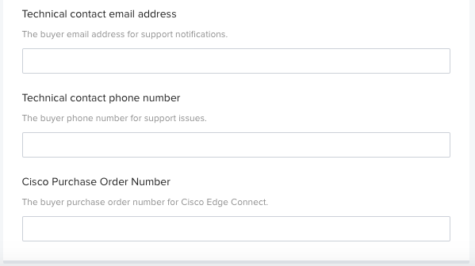
Equinix Fabric Connection (VC) Ordering
BGP Peer subnet and mask – Customer Provided
Customer advertised routes – Public for Webex Calling MT, Default Route for DI
PO# from CCW Order – Used by Cisco to cross reference the peering connection authorization

Slide 19
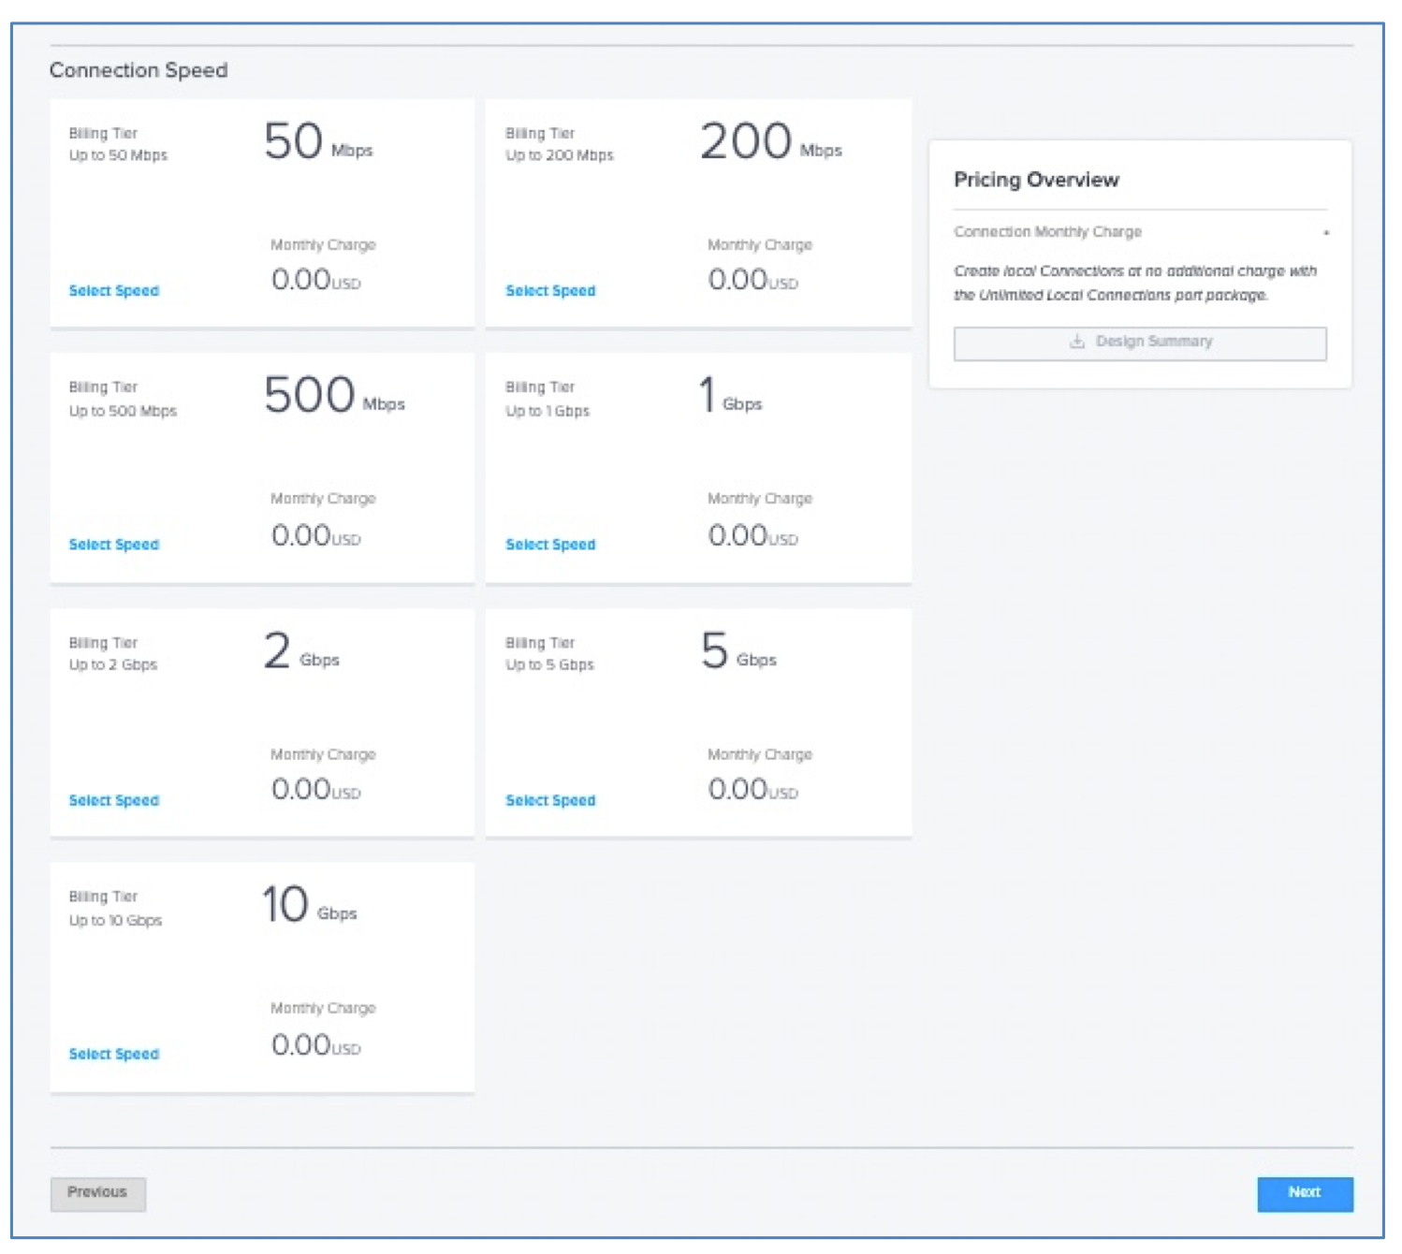
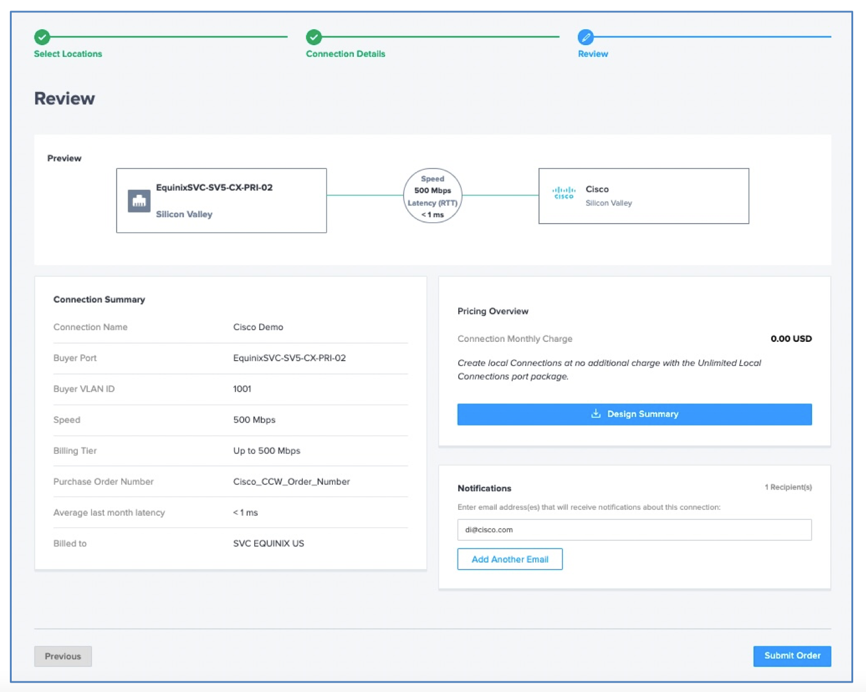
Equinix Fabric Connection (VC) Ordering

Slide 20
Useful References
https://help.webex.com/en-us/article/n68tcpb/Webex-Edge-Connect
https://www.cisco.com/c/dam/en/us/td/docs/solutions/PA/EdgeConnect/PA_Edge_Connect_Design.pdf

Slide 21


